Slide 1

x(시간) | t(점수)
10 | 95
8 | 80
5 | 68
2 | 15
1 | 5
Machine Learning
System
공부시간 – 점수 학습결과를
바탕으로
입력데이터에 없는
공부시간에 대한 점수 예측
Training Data Set
Test Data Set

Slide 2
x(시간) | t(점수)
10 | 95
8 | 80
5 | 68
2 | 15
1 | 5
Regression
Machine Learning
System
7시간 공부하면
몇 점 일까?
Training Data Set
예측하고자 하는 Data ( 7 )

Slide 3
x(시간) | t(합격여부)
10 | Pass
8 | Pass
5 | Fail
2 | Fail
1 | Fail
Classification
Machine Learning
System
7시간 공부하면
합격일까 불합격일까?
Training Data Set
예측하고자 하는 Data ( 7 )

Slide 4
x(시간) | t(점수)
10 | 95
8 | 80
5 | 68
2 | 15
1 | 5
Linear Regression
Machine Learning
System
7시간 공부하면
몇 점 일까?
Training Data Set
예측하고자 하는 Data ( 7 )

Slide 5
x(시간) | t(합격여부)
10 | Pass
8 | Pass
5 | Fail
2 | Fail
1 | Fail
Binary Classification
Machine Learning
System
7시간 공부하면
합격일까 불합격일까?
Training Data Set
예측하고자 하는 Data ( 7 )

Slide 6
x(시간) | t(Grade)
10 | A
8 | B
5 | D
2 | F
1 | F
Multinomial Classification
Machine Learning
System
7시간 공부하면
어떤 Grade일까?
Training Data Set
예측하고자 하는 Data ( 7 )

Slide 7
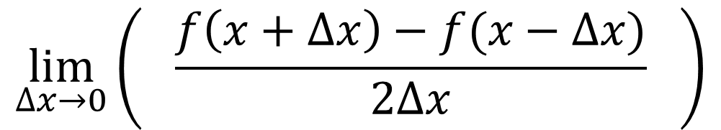
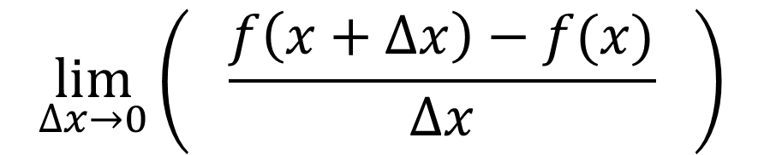
$$\lim_{∆x→0}\left( \frac{f\left(x+∆x\right)−f(x)}{∆x} \right)$$
$$\lim_{∆x→0}\left( \frac{f\left(x+∆x\right)−f(x−∆x)}{2∆x} \right)$$
$$function f\left(x\right)=x^{2}, derivative f^{′}\left(x\right)=2x$$

Slide 8
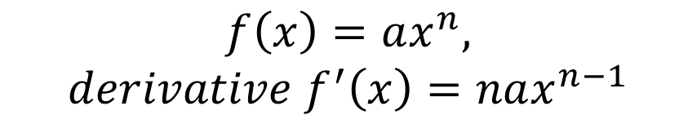

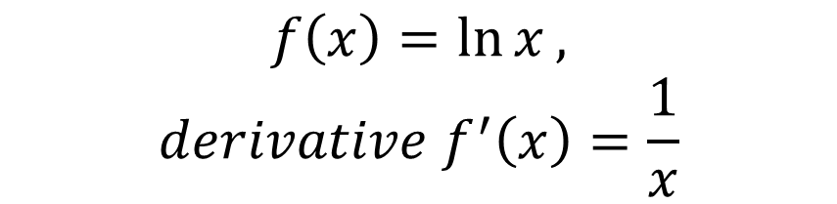
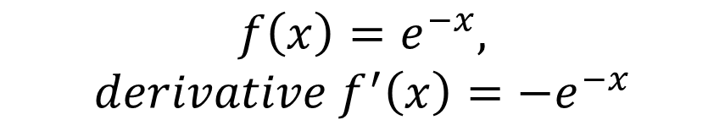

$$f\left(x\right)=constant,$$
$$derivative f^{′}\left(x\right)=0$$
$$f\left(x\right)=e^{−x},$$
$$derivative f^{′}\left(x\right)={−e}^{−x}$$
$$f\left(x\right)=ax^{n},$$
$$derivative f^{′}\left(x\right)=nax^{n−1}$$
$$f\left(x\right)=\ln{x},$$
$$derivative f^{′}\left(x\right)=\frac{1}{x}$$
$$f\left(x\right)=e^{x},$$
$$derivative f^{′}\left(x\right)=e^{x}$$

Slide 9


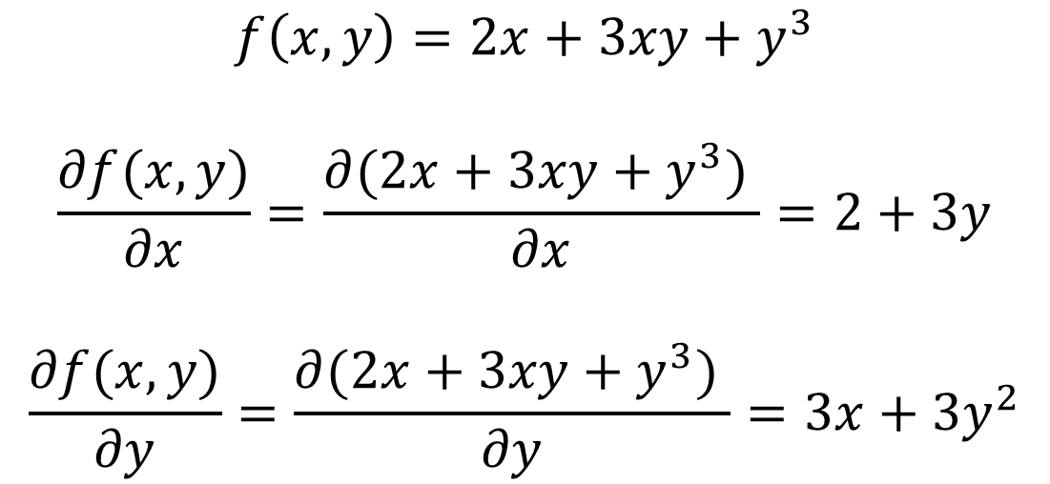

$$f\left(x\right)=3x^{2}+e^{x}+\frac{1}{x}$$
$$\frac{∂f(x,y)}{∂x}$$
$$f′\left(x\right)=6x+e^{x}−\frac{1}{x^{2}}$$
$$f\left(x,y\right)=2x+3xy+y^{3}$$
$$\frac{∂f(x,y)}{∂x}=\frac{∂(2x+3xy+y^{3}) }{∂x}=2+3y$$
$$\frac{∂f(x,y)}{∂y}=\frac{∂(2x+3xy+y^{3}) }{∂y}=3x+3y^{2}$$

Slide 10
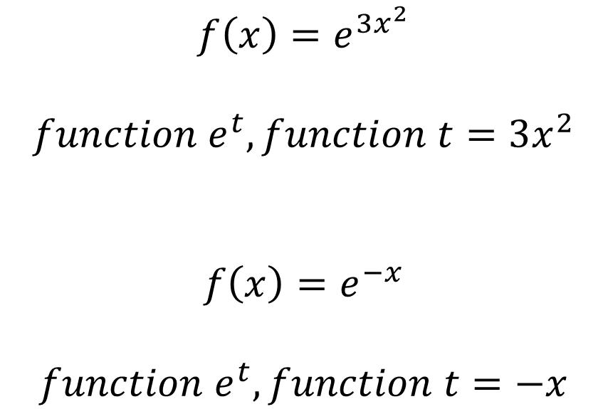
$$f\left(x\right)=e^{3x^{2}}$$
$$function e^{t}, function t=3x^{2}$$
$$f\left(x\right)=e^{−x}$$
$$function e^{t}, function t=−x$$

Slide 11
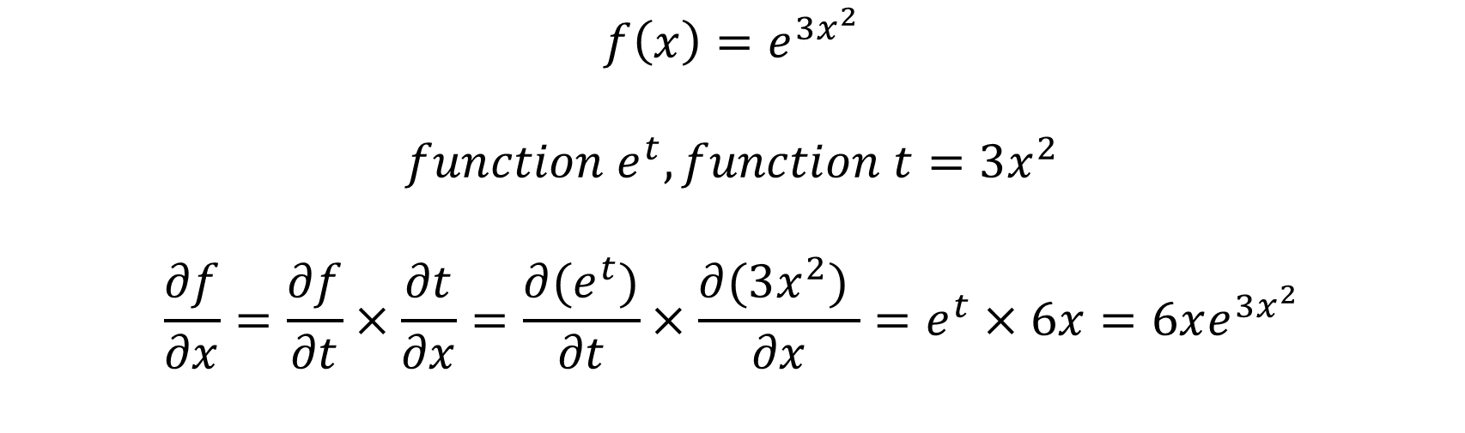
$$f\left(x\right)=e^{3x^{2}}$$
$$function e^{t}, function t=3x^{2}$$
$$\frac{∂f}{∂x}=\frac{∂f}{∂t}×\frac{∂t}{∂x}=\frac{∂(e^{t})}{∂t}×\frac{∂(3x^{2}) }{∂x}=e^{t}×6x=6xe^{3x^{2}}$$
$$f^{′}\left(x\right)=\frac{df(x)}{dx}=\lim_{∆x→0}\left( \frac{f\left(x+∆x\right)−f(x)}{∆x} \right)=\lim_{∆x→0}\left( \frac{f\left(x+∆x\right)−f(x−∆x)}{2∆x} \right)$$

Slide 12
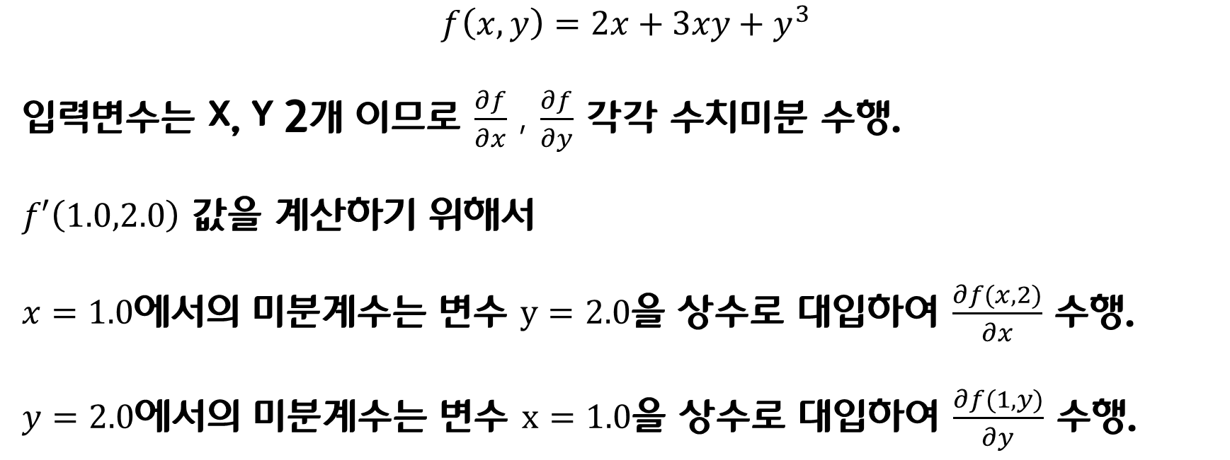
$$f\left(x,y\right)=2x+3xy+y^{3}$$
입력변수는 x, y 2개 이므로 $\frac{∂f}{∂x}$ , $\frac{∂f}{∂y}$ 각각 수치미분 수행.
$f′\left(1.0,2.0\right)$ 값을 계산하기 위해서
$x=1.0$에서의 미분계수는 변수 $y=2.0$을 상수로 대입하여 $\frac{∂f(x,2)}{∂x}$ 수행.
$y=2.0$에서의 미분계수는 변수 $x=1.0$을 상수로 대입하여 $\frac{∂f(1,y)}{∂y}$ 수행.

Slide 13
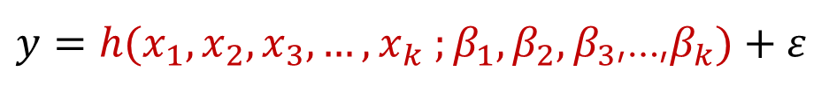


$f\left(x,y\right)=2x+3xy+y^{3}$, 인 경우 $f′\left(1.0,2.0\right)$ = $\left(8.0,15.0\right)$
$y=h(x_{1},x_{2},x_{3}, …,x_{k} ;β_{1},β_{2},β_{3}$,…,$β_{k})+ε$
$$y=β_{0}+β_{1}x$$
$$y=ax+b$$

Slide 14

$$y=β_{0}+β_{1}x+β_{2}x^{2}+β_{3}x^{3}$$
$$y=β_{0}x^{β_{1}}$$
$$\log{(y)}=\log\left(β_{0}x^{β_{1}}\right)$$
$$\log{(y)}=log\left(β_{0}\right)+β_{1}log(x)$$
$$y=\frac{e^{β_{1}x_{1}+β_{2}x_{2}+β_{3}x_{3}}}{1+e^{β_{1}x_{1}+β_{2}x_{2}+β_{3}x_{3}}}$$
$$\frac{y}{1−y}=e^{β_{1}x_{1}+β_{2}x_{2}+β_{3}x_{3}}$$
$$\log{(\frac{y}{1−y})}={β_{1}x_{1}+β_{2}x_{2}+β_{3}x_{3}}$$

Slide 15

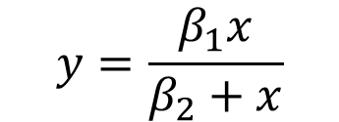

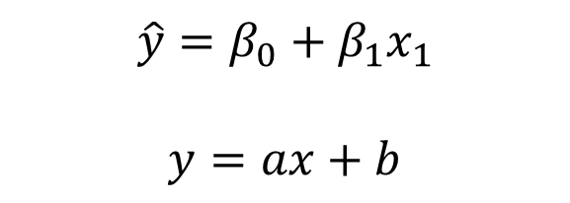
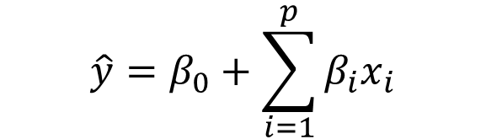
$$y=\frac{β_{1}x}{β_{2}+x}$$
$y=h(x_{1},x_{2},x_{3}, …,x_{k} ;β_{1},β_{2},β_{3}$,…,$β_{k})+ε$
$$\hat{y}=β_{0}+\sum_{i=1}^{p}{β_{i}x_{i}}$$
$$\hat{y}=β_{0}+β_{1}x_{1}$$
$$y=ax+b$$
$$y=Wx+b$$
$$error=t−y=t−(Wx+b)$$

Slide 16

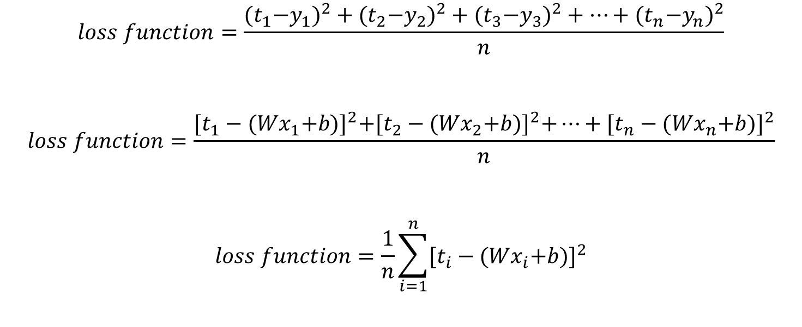
$$loss function=\frac{{{(t}_{1}−y_{1})}^{2}+{{(t}_{2}−y_{2})}^{2}+{{(t}_{3}−y_{3})}^{2}+…+{{(t}_{n}−y_{n})}^{2}}{n}$$
$$loss function=\frac{{[t_{1}−{(Wx}_{1}+b)]}^{2}+{[t_{2}−{(Wx}_{2}+b)]}^{2}+…+{[t_{n}−{(Wx}_{n}+b)]}^{2}}{n}$$
$$loss function=\frac{1}{n}\sum_{i=1}^{n}{{[t_{i}−{(Wx}_{i}+b)]}^{2}}$$
$$loss function, E(W,b)=\frac{1}{n}\sum_{i=1}^{n}{{[t_{i}−{(Wx}_{i}+b)]}^{2}}$$

Slide 17
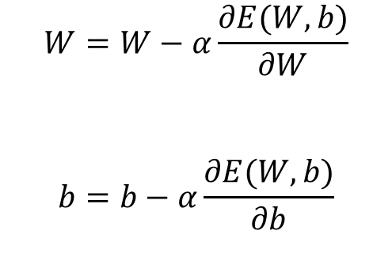


$$W=W−α\frac{∂E(W,b)}{∂W}$$
$$W=W−α\frac{∂E\left(W,b\right)}{∂W}, b=b−α\frac{∂E(W,b)}{∂b}$$
$$W=W−α\frac{∂E(W,b)}{∂W}$$
$$b=b−α\frac{∂E(W,b)}{∂b}$$

Slide 18
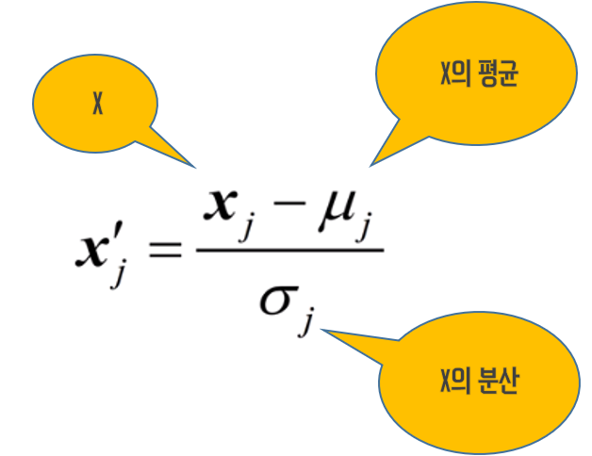
X의 표준편차

Slide 19




$$y=Wx+b$$
$$loss function, E(W,b)=\frac{1}{n}\sum_{i=1}^{n}{{[t_{i}−{(Wx}_{i}+b)]}^{2}}$$
x(시간) | t(점수)
10 | 95
8 | 80
5 | 68
2 | 15
1 | 5
Learning
계산된
손실함수
결과값
loss function
값 계산
계산된 Loss function값이
최소인가?
input
YES
학습종료
NO
Training Data Set
Weight, bias 업데이트
$$W=W−α\frac{∂E\left(W,b\right)}{∂W}, b=b−α\frac{∂E(W,b)}{∂b}$$

Slide 20
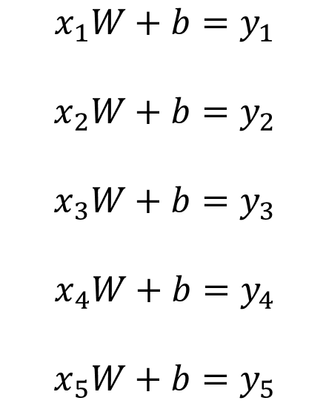

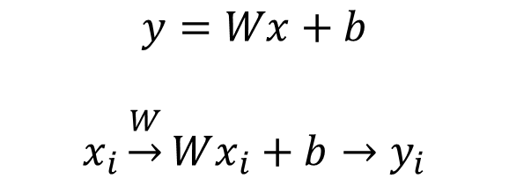


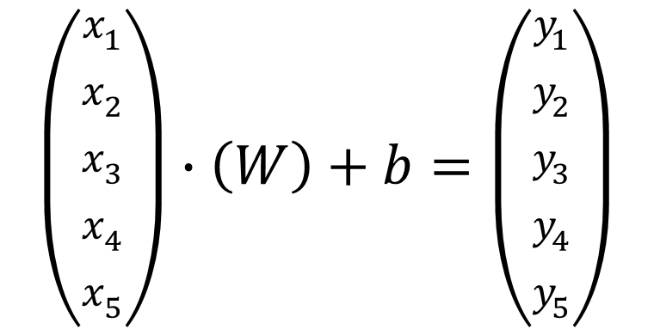
$$y=Wx+b$$
$$x_{i}\underset{→}{W}Wx_{i}+b→y_{i}$$
$$X∙W+b=Y$$
$$x_{1}W+b=y_{1}$$
$$x_{2}W+b=y_{2}$$
$$x_{3}W+b=y_{3}$$
$$x_{4}W+b=y_{4}$$
$$x_{5}W+b=y_{5}$$
$$\left(\begin{aligned}x_{1} \\ x_{2} \\ x_{3} \\ x_{4} \\ x_{5}\end{aligned}\right)∙\left(W\right)+b=\left(\begin{aligned}y_{1} \\ y_{2} \\ y_{3} \\ y_{4} \\ y_{5}\end{aligned}\right)$$
x(입력) | t(정답)
1 | 3
2 | 5
3 | 7
4 | 9
5 | 11
행렬변환
$$\left(5×1\right)∙\left(1×1\right)$$
$$\left(5×1\right)$$
Training Data Set

Slide 21
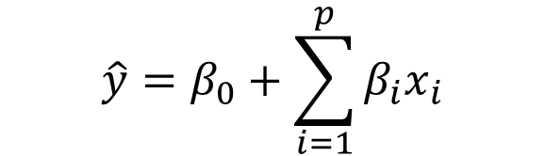



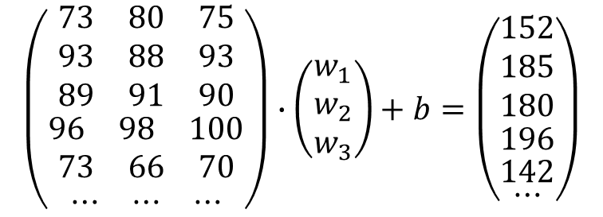
$$\hat{y}=β_{0}+\sum_{i=1}^{p}{β_{i}x_{i}}$$
$$y_{1}=w_{1}x_{1}+w_{2}x_{2}+w_{3}x_{3}+b$$
x1 | x2 | x3 | t(정답)
73 | 80 | 75 | 152
93 | 88 | 93 | 185
89 | 91 | 90 | 180
96 | 98 | 100 | 196
73 | 66 | 70 | 142
… | … | … | …
$$x_{1}w_{1}+x_{2}w_{2}+x_{3}w_{3}+b=y_{1}$$
$$X∙W+b=Y$$
$$\left(\begin{aligned}\begin{matrix}73 & 80 & 75 \\ 93 & 88 & 93 \\ 89 & 91 & 90\end{matrix} \\ \begin{matrix}96 & 98 & 100\end{matrix} \\ \begin{matrix}73 & 66 & 70\end{matrix} \\ \begin{matrix}⋯ & ⋯ & ⋯\end{matrix}\end{aligned}\right)∙\left(\begin{matrix}w_{1} \\ w_{2} \\ w_{3}\end{matrix}\right)+b=\left(\begin{aligned}\begin{aligned}\begin{aligned}\begin{matrix}152 \\ 185 \\ 180\end{matrix} \\ 196\end{aligned} \\ 142\end{aligned} \\ ⋯\end{aligned}\right)$$
Training Data Set
$$\left(25×3\right)∙\left(3×1\right)$$
$$\left(25×1\right)$$

Slide 22





Logistic Regression
Training Data Set
Or
Test Data Set
( x , t )
True (1)
Or
False (0)
Linear
Regression
Classification
Logistic Regression
Training Data Set
Or
Test Data Set
( x , t )
$$x$$
True (1)
Or
False (0)
Linear
Regression
Classification
$$y=sigmoid(z)$$
$$z=Wx+b$$
$$Wx+b$$
$$sigmoid$$

Slide 23



$$sigmoid, σ(x)=\frac{1}{1+e^{−x}}$$
$$y=Wx+b$$
$$Linear Regression, E(W,b)=\frac{1}{n}\sum_{i=1}^{n}{{[t_{i}−{(Wx}_{i}+b)]}^{2}}$$
$$y=\frac{1}{1+e^{−(Wx+b)}}$$
$$Logistic Regression, E(W,b)=\frac{1}{n}\sum_{i=1}^{n}{{[t_{i}−(\frac{1}{1+e^{−(Wx_{i}+b)}})]}^{2}}$$
$$y=\frac{1}{1+e^{−(Wx+b)}}$$

Slide 24
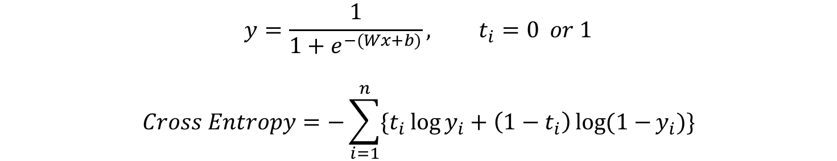
$$y=\frac{1}{1+e^{−(Wx+b)}}, t_{i}=0 or 1$$
$$Cross Entropy=−\sum_{i=1}^{n}{\{t_{i}\log{y_{i}}+\left(1−t_{i}\right)\log{(1−}y_{i})\}}$$

Slide 25
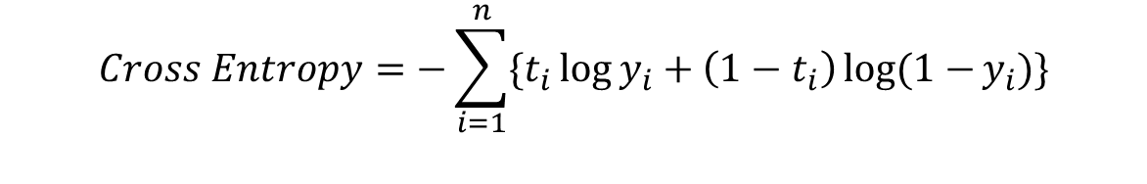


$$Cross Entropy=−\sum_{i=1}^{n}{\{t_{i}\log{y_{i}}+\left(1−t_{i}\right)\log{(1−}y_{i})\}}$$
x(입력) | t(정답)
x1 | t1
x2 | t2
x3 | t3
x4 | t4
x5 | t5
… | …
Learning (손실함수값 계산)
계산된
손실함수
결과값
계산된 Loss function값이
최소인가?
input
YES
학습종료
Linear
Regression
$$z=Wx+b$$
Classification
$$Wx+b$$
$$sigmoid$$
NO
Weight, bias 업데이트
Training Data Set
$$W=W−α\frac{∂E\left(W,b\right)}{∂W}, b=b−α\frac{∂E(W,b)}{∂b}$$

Slide 26



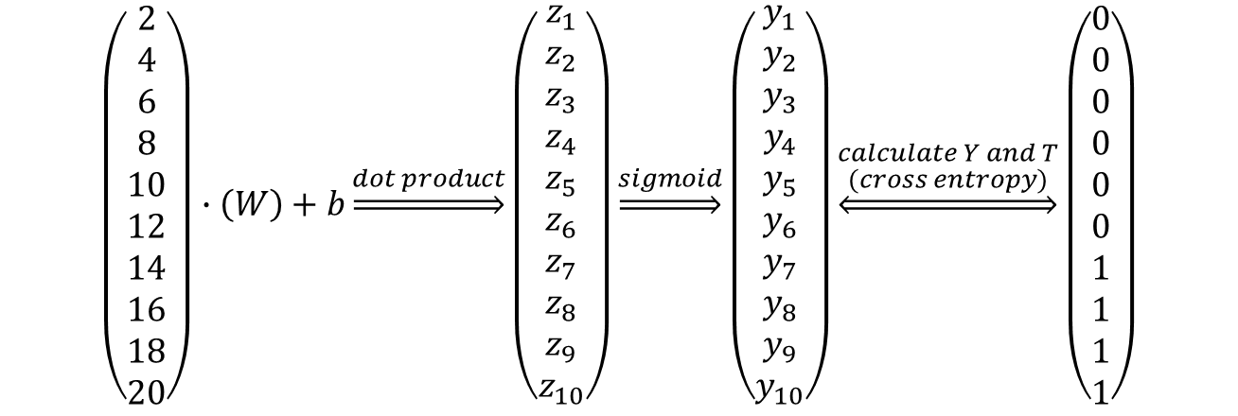




Linear
Regression
Classification
$$x$$
$$y$$
$$z=Wx+b$$
$$Wx+b$$
$$sigmoid(z)$$
x(공부시간) | t(Pass/Fail)
2 | 0
4 | 0
6 | 0
8 | 0
10 | 0
12 | 0
14 | 1
16 | 1
18 | 1
20 | 1
$$\left(\begin{aligned}2 \\ 4 \\ 6 \\ 8 \\ 10 \\ 12 \\ 14 \\ 16 \\ 18 \\ 20\end{aligned}\right)∙\left(W\right)+b\underset{⇒}{dot product}\left(\begin{aligned}z_{1} \\ z_{2} \\ z_{3} \\ z_{4} \\ z_{5} \\ z_{6} \\ z_{7} \\ z_{8} \\ z_{9} \\ z_{10}\end{aligned}\right)\underset{⇒}{sigmoid}\left(\begin{aligned}y_{1} \\ y_{2} \\ y_{3} \\ y_{4} \\ y_{5} \\ y_{6} \\ y_{7} \\ y_{8} \\ y_{9} \\ y_{10}\end{aligned}\right)\underset{⇔}{\begin{aligned}calculate Y and T \\ (cross entropy)\end{aligned}}\left(\begin{aligned}0 \\ 0 \\ 0 \\ 0 \\ 0 \\ 0 \\ 1 \\ 1 \\ 1 \\ 1\end{aligned}\right)$$
$$\left(10×1\right)∙\left(1×1\right)$$
$$\left(10×1\right)$$
$$\left(10×1\right)$$
$$\left(10×1\right)$$
입력행렬
Linear
Regression
출력행렬
Sigmoid
결과행렬
정답행렬
Training Data Set

Slide 27
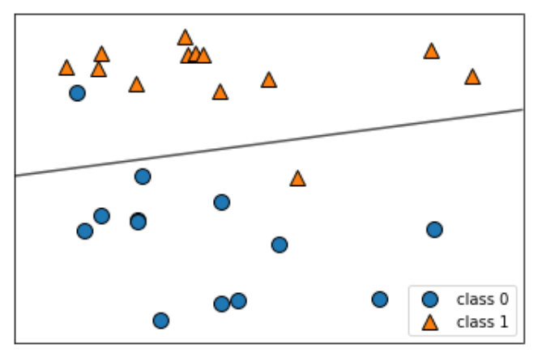
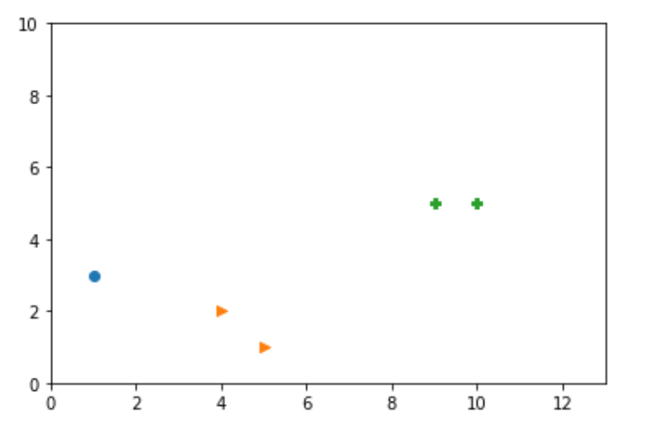
이 선을 찾아내는 것 ( hyperplane)
x1(성적) | x2(출석) | t(Grade)
10 | 5 | A
9 | 5 | A
5 | 1 | B
4 | 2 | B
1 | 3 | C
A
C
B

Slide 28
A
C
B

Slide 29
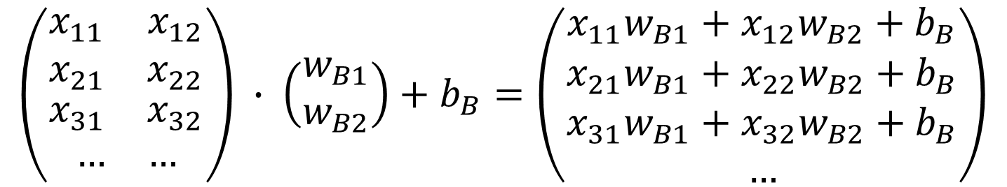
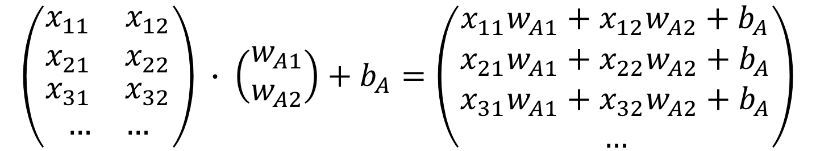
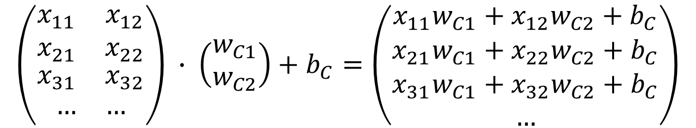
$$\left(\begin{aligned}\begin{matrix}x_{11} & x_{12} \\ x_{21} & x_{22}\end{matrix} \\ \begin{matrix}x_{31} & x_{32}\end{matrix} \\ \begin{matrix}… & …\end{matrix}\end{aligned}\right) ∙ \left(\begin{matrix}w_{A1} \\ w_{A2}\end{matrix}\right)+b_{A}=\left(\begin{aligned}x_{11}w_{A1}+x_{12}w_{A2}+b_{A} \\ \begin{matrix}x_{21}w_{A1}+x_{22}w_{A2}+b_{A} \\ x_{31}w_{A1}+x_{32}w_{A2}+b_{A} \\ …\end{matrix}\end{aligned}\right)$$
$$\left(\begin{aligned}\begin{matrix}x_{11} & x_{12} \\ x_{21} & x_{22}\end{matrix} \\ \begin{matrix}x_{31} & x_{32}\end{matrix} \\ \begin{matrix}… & …\end{matrix}\end{aligned}\right) ∙ \left(\begin{matrix}w_{B1} \\ w_{B2}\end{matrix}\right)+b_{B}=\left(\begin{aligned}x_{11}w_{B1}+x_{12}w_{B2}+b_{B} \\ \begin{matrix}x_{21}w_{B1}+x_{22}w_{B2}+b_{B} \\ x_{31}w_{B1}+x_{32}w_{B2}+b_{B} \\ …\end{matrix}\end{aligned}\right)$$
$$\left(\begin{aligned}\begin{matrix}x_{11} & x_{12} \\ x_{21} & x_{22}\end{matrix} \\ \begin{matrix}x_{31} & x_{32}\end{matrix} \\ \begin{matrix}… & …\end{matrix}\end{aligned}\right) ∙ \left(\begin{matrix}w_{C1} \\ w_{C2}\end{matrix}\right)+b_{C}=\left(\begin{aligned}x_{11}w_{C1}+x_{12}w_{C2}+b_{C} \\ \begin{matrix}x_{21}w_{C1}+x_{22}w_{C2}+b_{C} \\ x_{31}w_{C1}+x_{32}w_{C2}+b_{C} \\ …\end{matrix}\end{aligned}\right)$$

Slide 30
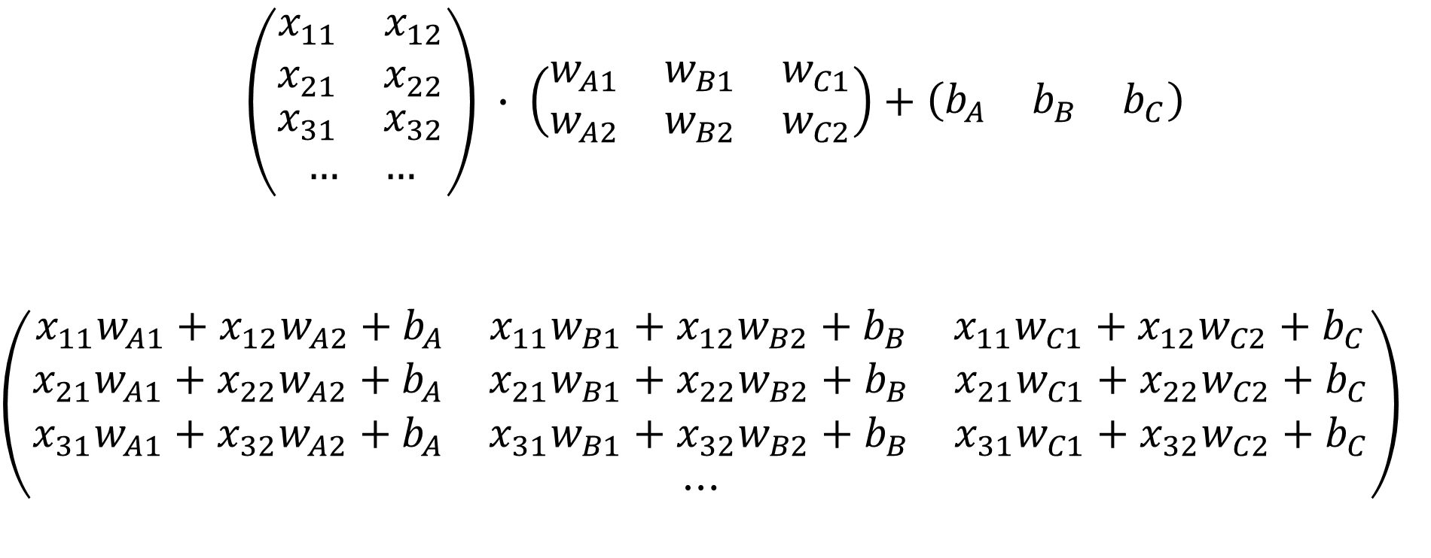
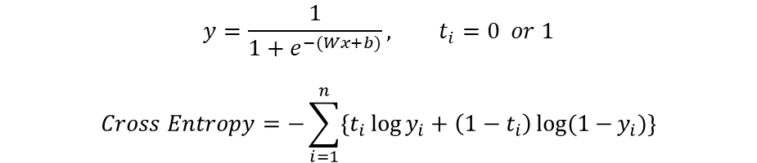
$$\left(\begin{aligned}\begin{matrix}x_{11} & x_{12} \\ x_{21} & x_{22}\end{matrix} \\ \begin{matrix}x_{31} & x_{32}\end{matrix} \\ \begin{matrix}… & …\end{matrix}\end{aligned}\right) ∙ \left(\begin{matrix}\begin{matrix}w_{A1} \\ w_{A2}\end{matrix} & \begin{matrix}w_{B1} \\ w_{B2}\end{matrix} & \begin{matrix}w_{C1} \\ w_{C2}\end{matrix}\end{matrix}\right)+\left(\begin{matrix}b_{A} & b_{B} & b_{C}\end{matrix}\right)$$
$$\left(\begin{aligned}\begin{matrix}x_{11}w_{A1}+x_{12}w_{A2}+b_{A} & x_{11}w_{B1}+x_{12}w_{B2}+b_{B} & x_{11}w_{C1}+x_{12}w_{C2}+b_{C}\end{matrix} \\ \begin{matrix}x_{21}w_{A1}+x_{22}w_{A2}+b_{A} & x_{21}w_{B1}+x_{22}w_{B2}+b_{B} & x_{21}w_{C1}+x_{22}w_{C2}+b_{C}\end{matrix} \\ \begin{matrix}x_{31}w_{A1}+x_{32}w_{A2}+b_{A} & x_{31}w_{B1}+x_{32}w_{B2}+b_{B} & x_{31}w_{C1}+x_{32}w_{C2}+b_{C}\end{matrix} \\ ⋯\end{aligned}\right)$$
$$y=\frac{1}{1+e^{−(Wx+b)}}, t_{i}=0 or 1$$
$$Cross Entropy=−\sum_{i=1}^{n}{\{t_{i}\log{y_{i}}+\left(1−t_{i}\right)\log{(1−}y_{i})\}}$$
$$\left(\begin{matrix}0.7122 & 0.8585 & 0.2347\end{matrix}\right)$$
A
B
C

Slide 31

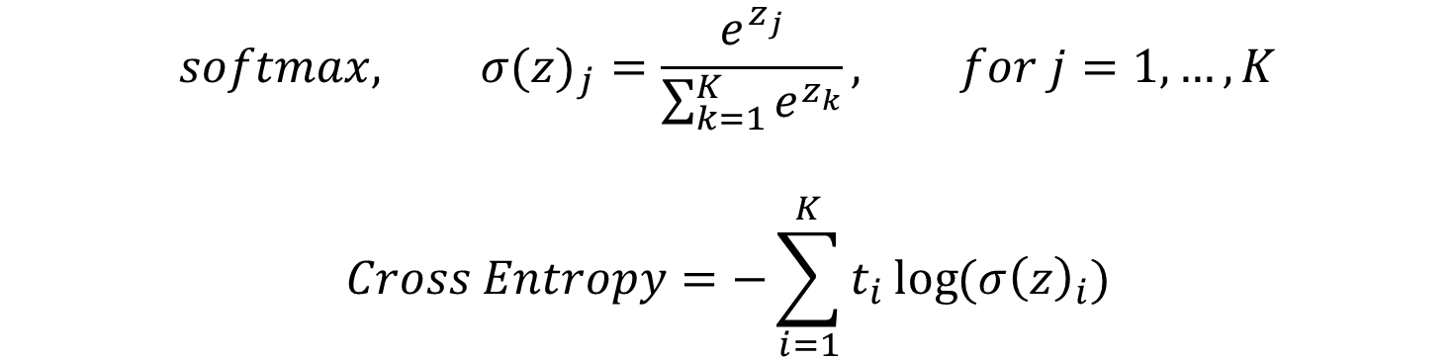
$$softmax, {σ(z)}_{j}=\frac{e^{z_{j}}}{\sum_{k=1}^{K}{e^{z_{k}}}}, for j=1,…,K$$
$$Cross Entropy=−\sum_{i=1}^{K}{t_{i}\log{({σ\left(z\right)}_{i})}}$$
$$z$$
Linear
Regression
2.0
softmax
0.7
P(y=0)
1.0
0.2
P(y=1)
0.1
0.1
P(y=2)
logits
probability

Slide 32
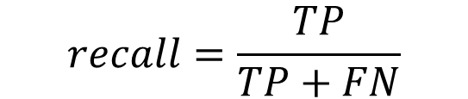
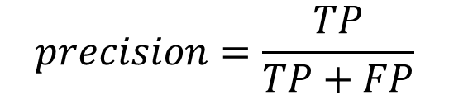
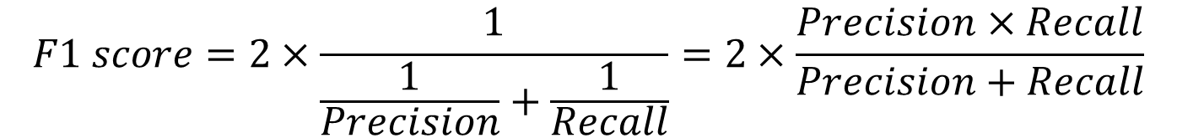
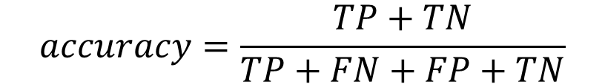
Confusion Matrix |  | 실제정답
 |  | True | False
분류결과 | True | True Positive | False Positive
 | False | False Negative | True Negative
$$precision=\frac{TP}{TP+FP}$$
$$accuracy=\frac{TP+TN}{TP+FN+FP+TN}$$
$$recall=\frac{TP}{TP+FN}$$
$$F1 score=2×\frac{1}{\frac{1}{Precision}+\frac{1}{Recall}}=2×\frac{Precision×Recall}{Precision+Recall}$$

Slide 33
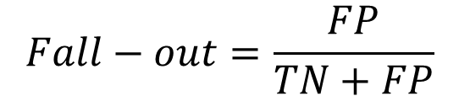
$$Fall−out=\frac{FP}{TN+FP}$$
a
b
Recall
a
F1 Score
b
Precision

Slide 34
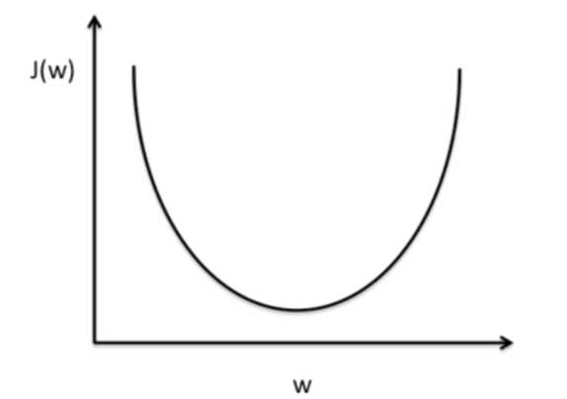

Slide 35
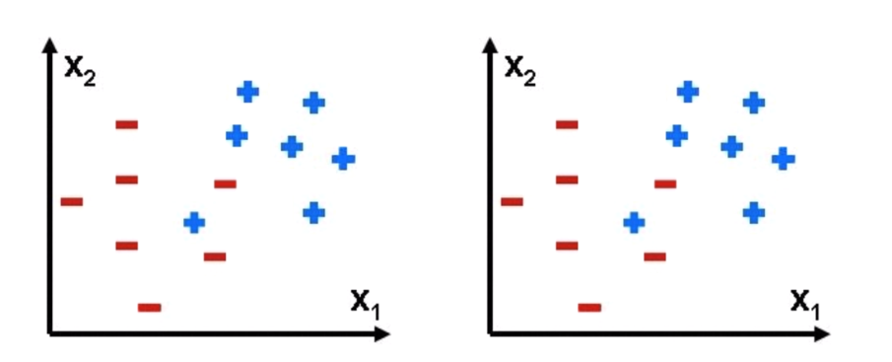
Overfitting
loss = tf.reduce_mean(tf.square(H-Y)) + 0.001 * tf.reduce_sum(tf.square(W))
Regularization Strength

Slide 36
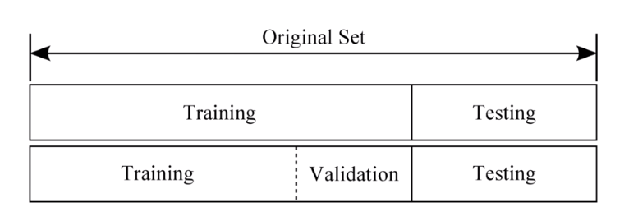

Slide 37
Fold 1
Fold 2
Fold 3
Fold 4
Fold 5
TesT
Training
Training
Training
Training
Test
Training
TesT
Training
Training
Training
Test
Training Data Set
Average Accuracy
Training
Training
TesT
Training
Training
Test
Training
Training
Training
TesT
Training
Test
Training
Training
Training
Training
TesT
Test

Slide 38
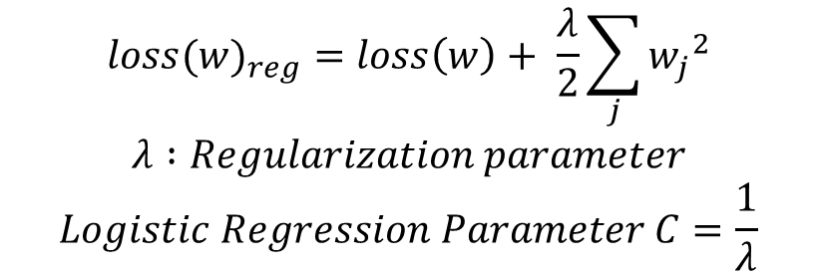
One-Hot Encoding
t(Grade) |  | A | B | C
A |  | 1 | 0 | 0
A |  | 1 | 0 | 0
B |  | 0 | 1 | 0
B |  | 0 | 1 | 0
C |  | 0 | 0 | 1
$${loss(w)}_{reg}=loss\left(w\right)+ \frac{λ}{2}\sum_{j}{{w_{j}}^{2}}$$
$$λ :Regularization parameter$$
$$Logistic Regression Parameter C=\frac{1}{λ}$$

Slide 39
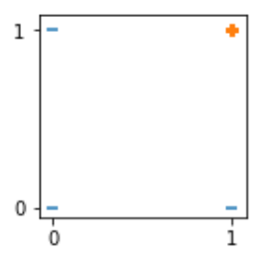
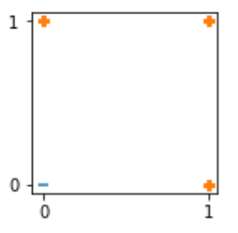
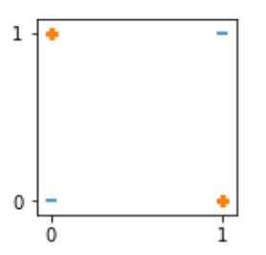
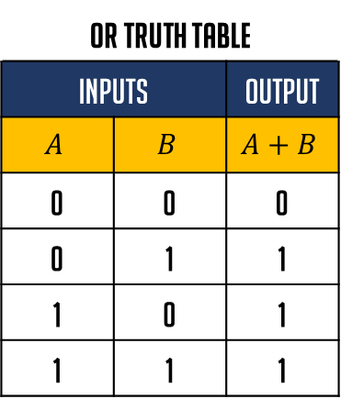
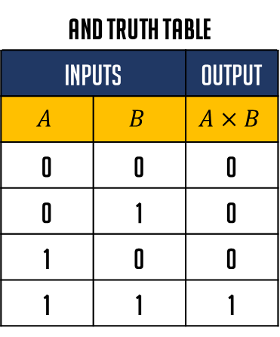
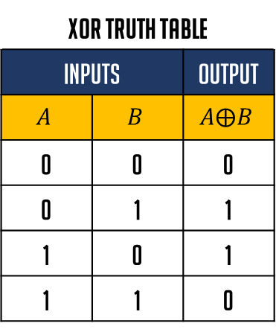
AND Truth Table
Inputs |  | Output
$$A$$ | $$B$$ | $$A×B$$
0 | 0 | 0
0 | 1 | 0
1 | 0 | 0
1 | 1 | 1
OR Truth Table
Inputs |  | Output
$$A$$ | $$B$$ | $$A+B$$
0 | 0 | 0
0 | 1 | 1
1 | 0 | 1
1 | 1 | 1
XOR Truth Table
Inputs |  | Output
$$A$$ | $$B$$ | $$A⨁B$$
0 | 0 | 0
0 | 1 | 1
1 | 0 | 1
1 | 1 | 0
AND
OR
XOR
?

Slide 40
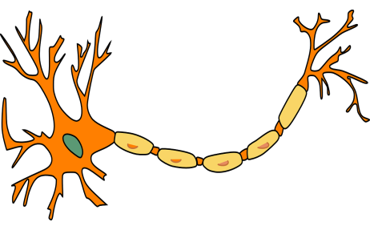










$$x_{1}$$
$$w_{1}$$
Linear
Regression
Classification
$$y$$
$$x_{2}$$
$$w_{2}$$
$$w_{3}$$
$${z=w}_{1}x_{1}+w_{2}x_{2}+w_{3}x_{3}+b$$
$$y=sigmoid(z)$$
$$x_{3}$$
Neural network (신경망)
INPUT
OUTPUT

Slide 41
Artificial Neural network (인공신경망)
…
…
…
…
…
…
Logistic
regression
Logistic
regression
Logistic
regression
INPUT
…
…
…
…
…
…
…
…
…
OUTPUT
Logistic
regression
Logistic
regression
Logistic
regression
…
…
…
…
…
…

Slide 42















Deep learning
입력층
$$W^{(1)}$$
은닉층1
$$W^{(2)}$$
…..
은닉층K
$$W^{(k)}$$
출력층
…..
…..
…..
…..
…..
…..
…..
…..
…..
…..
…..
…..
출력1
입력1
$$w_{11}$$
$$w_{11}$$
$$w_{11}$$
1
1
1
1
$$w_{21}$$
$$w_{21}$$
$$w_{21}$$
입력2
출력2
2
2
2
2
…..
…..
…..
…..
입력N
$$w_{2N}$$
$$w_{2M}$$
출력l
n
M
K
$$w_{2K}$$
L
$$w_{MN}$$
$$w_{KM}$$
$$w_{LK}$$
Propagation ( Feed Forward )

Slide 43





Logistic Regression
$$input$$
$$output$$
Linear
Regression
Classification
$$z$$
$$z=Wx+b$$
$$sigmoid(z)$$
Propagation

Slide 44



























입력층( 계층 1 )
계층 2
계층 3
$$x_{1}$$
$${a_{1}}^{(1)}$$
$${w_{11}}^{(2)}$$
$${a_{1}}^{(2)}$$
$${w_{11}}^{(3)}$$
$${b_{1}}^{(2)}$$
$${b_{1}}^{(3)}$$
$${a_{1}}^{(3)}$$
$${w_{21}}^{(2)}$$
$${a_{1}}^{(2)}$$
$${w_{21}}^{(3)}$$
$${a_{1}}^{(3)}$$
$${z_{1}}^{(2)}$$
$${z_{1}}^{(3)}$$
$${w_{12}}^{(2)}$$
$${w_{12}}^{(3)}$$
$${z_{2}}^{(2)}$$
$${z_{2}}^{(3)}$$
$${a_{2}}^{(3)}$$
$${w_{22}}^{(2)}$$
$${a_{2}}^{(2)}$$
$${w_{22}}^{(3)}$$
$${a_{2}}^{(3)}$$
$$x_{2}$$
$${a_{2}}^{(1)}$$
$${b_{2}}^{(2)}$$
$${a_{2}}^{(2)}$$
$${b_{2}}^{(3)}$$
$${a_{2}}^{(2)}=sigmoid({z_{2}}^{\left(2\right)})$$
$${z_{2}}^{(2)}={a_{1}}^{(1)}{w_{21}}^{(2)}+{a_{2}}^{(1)}{w_{22}}^{(2)}+{b_{2}}^{(2)}$$

Slide 45

$${z_{1}}^{(2)}={a_{1}}^{(1)}{w_{11}}^{(2)}+{a_{2}}^{(1)}{w_{12}}^{(2)}+{b_{1}}^{(2)}$$
$${z_{2}}^{(2)}={a_{1}}^{(1)}{w_{21}}^{(2)}+{a_{2}}^{(1)}{w_{22}}^{(2)}+{b_{2}}^{(2)}$$
$$\left(\begin{matrix}{z_{1}}^{(2)} & {z_{2}}^{(2)}\end{matrix}\right)=\left(\begin{matrix}{a_{1}}^{(1)} & {a_{2}}^{(1)}\end{matrix}\right)⋅\left(\begin{matrix}{w_{11}}^{(2)} & {w_{21}}^{(2)} \\ {w_{12}}^{(2)} & {w_{22}}^{(2)}\end{matrix}\right)+\left(\begin{matrix}{b_{1}}^{(2)} & {b_{2}}^{(2)}\end{matrix}\right)$$

Slide 46






$$Cross Entropy=−\sum_{i=1}^{n}{\{t_{i}\log{y_{i}}+\left(1−t_{i}\right)\log{(1−}y_{i})\}}$$
Feed forward
Input layer
hidden layer
output layer
x(입력) | t(정답)
x1 | t1
x2 | t2
x3 | t3
x4 | t4
x5 | t5
… | …
$$W^{(2)}$$
$$W^{(3)}$$
계산된 Loss function값이
최소인가?
input
Y
YES
학습종료
$$b^{(2)}$$
$$b^{(3)}$$
NO
Weight, bias 업데이트
Training Data Set
$$W^{(2)}=W^{(2)}−α\frac{∂E\left(W,b\right)}{∂W^{(2)}}, b^{(2)}=b^{(2)}−α\frac{∂E\left(W,b\right)}{∂b^{(2)}}$$
$$W^{(3)}=W^{(3)}−α\frac{∂E\left(W,b\right)}{∂W^{(3)}}, b^{(3)}=b^{(3)}−α\frac{∂E\left(W,b\right)}{∂b^{(3)}}$$

Slide 47














$$Cross Entropy=−\sum_{i=1}^{n}{\{t_{i}\log{y_{i}}+\left(1−t_{i}\right)\log{(1−}y_{i})\}}$$
Feed forward
Input layer
$$W^{(2)}$$
hidden layer
$$W^{(3)}$$
output layer
계산된 Loss function값이
최소인가?
$$A1⋅W^{2}+b^{2}$$
$$A2⋅W^{3}+b^{3}$$
YES
학습종료
Training Data Set
X , T
Y
$$A1$$
$$Z2$$
$$Z3$$
$$relu(Z2)$$
$$softmax(Z3)$$
$$A2$$
$$A3$$
$$b^{(2)}$$
$$b^{(3)}$$
NO
Weight, bias 업데이트

Slide 48













$$Cross Entropy=−\sum_{i=1}^{n}{\{t_{i}\log{y_{i}}+\left(1−t_{i}\right)\log{(1−}y_{i})\}}$$
Feed forward
Input
layer
Convolution
layer
Pooling
Layer
Convolution
layer
Pooling
Layer
FC
Layer
output layer
Pool
I
ng
$$A2$$
Pool
I
ng
$$A3$$
F
Lat
T
en
계산된 Loss function값이
최소인가?
$$conv$$
$$conv$$
$$Linear$$
$$Regression$$
YES
학습종료
Training Data Set
X , T
$$C3$$
Y
$$C2$$
$$Z4$$
$$A1$$
$$Z2$$
$$Z3$$
$$softmax(Z4)$$
$$relu$$
$$relu$$
$$A4$$
$$W^{(2)},b^{(2)}$$
$$W^{(3)},b^{(3)}$$
$$W^{(4)},b^{(4)}$$
NO
Weight, bias 업데이트

Slide 49



Filter (3x3)
$$1×1+1×0+1×1$$
$$0×0+1×1+1×0$$
$$0×1+0×0+1×1$$
$$=4$$
$$1×1+1×0+0×1$$
$$1×0+1×1+1×0$$
$$0×1+1×0+1×1$$
$$=3$$
$$1×1+0×0+0×1$$
$$1×0+1×1+0×0$$
$$1×1+1×0+1×1$$
$$=4$$
1 | 0 | 1
0 | 1 | 0
1 | 0 | 1
Image Data (5x5)
Image Data (5x5)
Image Data (5x5)
1 | 1 | 1 | 0 | 0
0 | 1 | 1 | 1 | 0
0 | 0 | 1 | 1 | 1
0 | 0 | 1 | 1 | 0
0 | 1 | 1 | 0 | 0
Feature map (3x3)
1 | 1 | 1 | 0 | 0
0 | 1 | 1 | 1 | 0
0 | 0 | 1 | 1 | 1
0 | 0 | 1 | 1 | 0
0 | 1 | 1 | 0 | 0
Feature map (3x3)
1 | 1 | 1 | 0 | 0
0 | 1 | 1 | 1 | 0
0 | 0 | 1 | 1 | 1
0 | 0 | 1 | 1 | 0
0 | 1 | 1 | 0 | 0
Feature map (3x3)
4
4 | 3
4 | 3 | 4
Image Data (5x5)
Image Data (5x5)
Image Data (5x5)
1 | 1 | 1 | 0 | 0
0 | 1 | 1 | 1 | 0
0 | 0 | 1 | 1 | 1
0 | 0 | 1 | 1 | 0
0 | 1 | 1 | 0 | 0
Feature map (3x3)
1 | 1 | 1 | 0 | 0
0 | 1 | 1 | 1 | 0
0 | 0 | 1 | 1 | 1
0 | 0 | 1 | 1 | 0
0 | 1 | 1 | 0 | 0
Feature map (3x3)
1 | 1 | 1 | 0 | 0
0 | 1 | 1 | 1 | 0
0 | 0 | 1 | 1 | 1
0 | 0 | 1 | 1 | 0
0 | 1 | 1 | 0 | 0
Feature map (3x3)
4 | 3 | 4
2
4 | 3 | 4
2 | 4
4 | 3 | 4
2 | 4 | 3
Image Data (5x5)
Image Data (5x5)
Image Data (5x5)
1 | 1 | 1 | 0 | 0
0 | 1 | 1 | 1 | 0
0 | 0 | 1 | 1 | 1
0 | 0 | 1 | 1 | 0
0 | 1 | 1 | 0 | 0
Feature map (3x3)
1 | 1 | 1 | 0 | 0
0 | 1 | 1 | 1 | 0
0 | 0 | 1 | 1 | 1
0 | 0 | 1 | 1 | 0
0 | 1 | 1 | 0 | 0
Feature map (3x3)
1 | 1 | 1 | 0 | 0
0 | 1 | 1 | 1 | 0
0 | 0 | 1 | 1 | 1
0 | 0 | 1 | 1 | 0
0 | 1 | 1 | 0 | 0
Feature map (3x3)
4 | 3 | 4
2 | 4 | 3
2
4 | 3 | 4
2 | 4 | 3
2 | 3
4 | 3 | 4
2 | 4 | 3
2 | 3 | 4

Slide 50
1 | 0 | 0 | 0
1 | 1 | 1 | 1
0 | 1 | 1 | 0
1 | 1 | 0 | 1
1 | 0 | 0 | 0
0 | 1 | 1 | 1
0 | 0 | 0 | 0
1 | 0 | 0 | 1
1 | 0 | 0 | 0
1 | 0 | 1 | 0
0 | 0 | 0 | 0
1 | 0 | 0 | 1
channel
1 | 0 | 0 | 0
1 | 1 | 1 | 1
0 | 1 | 1 | 0
1 | 1 | 0 | 1
1 | 0 | 0 | 0
0 | 1 | 1 | 1
0 | 0 | 0 | 0
1 | 0 | 0 | 1
1 | 0 | 0 | 0
1 | 0 | 1 | 0
0 | 0 | 0 | 0
1 | 0 | 0 | 1
Filter
1 | 0 | 0
0 | 1 | 1
1 | 0 | 1
1 | 0 | 1
0 | 0 | 1
0 | 1 | 1
1 | 0 | 1
0 | 1 | 0
0 | 1 | 1
Convolution
Result Of
channel
+
+
4 | 3
4 | 4
2 | 1
1 | 3
1 | 1
2 | 1
Feature map
7 | 5
7 | 8

Slide 51
sklearn.metrics.confusion_matrix()
binary classification
0 | 0 | 0 | 0 | 0 | 0
0 | 1 | 0 | 0 | 0 | 0
0 | 0 | 1 | 1 | 1 | 0
0 | 0 | 0 | 0 | 0 | 0
0 | 1 | 0 | 0 | 1 | 0
0 | 0 | 0 | 0 | 0 | 0
Confusion Matrix |  | 분류결과
 |  | False | true
실제정답 | False | True negative | False Positive
 | true | False Negative | True positive
y_true = [ 2, 0, 2, 2, 0, 1 ]
y_pred = [ 0, 0, 2, 2, 0, 2 ]
Confusion Matrix |  | 분류결과
 |  | 0 | 1 | 2
실제정답 | 0 | 2 | 0 | 0
 | 1 | 0 | 0 | 1
 | 2 | 1 | 0 | 2

Slide 52

Feature Map
13 | 20 | 30 | 0
8 | 12 | 3 | 0
34 | 70 | 33 | 5
111 | 80 | 10 | 23
Max pooling
average pooling
Min pooling
20 | 30
111 | 33
13 | 8
66 | 18
8 | 0
34 | 5
Keras(High-Level API)
TensorFlow(Back-End)
CPU / GPU / TPU

Slide 53
$$Cross Entropy=−\sum_{i=1}^{n}{\{t_{i}\log{y_{i}}+\left(1−t_{i}\right)\log{(1−}y_{i})\}}$$
Feed forward
x(입력) | t(정답)
x1 | t1
x2 | t2
x3 | t3
x4 | t4
x5 | t5
… | …
Input layer
hidden layer
output layer
계산된 Loss function값이
최소인가?
input
Y
YES
학습종료
Model
Training Data Set
NO
Weight, bias 업데이트

Slide 54
Keras 개발과정
Keras API
데이터 생성
model = Sequential()
model.add(…)
…
model.add(…)
Model 구축
Model 컴파일
model.compile(…)
Model 학습
model.fit(…)
Model Evaluation 및 Prediction
model.evaluate(…)
model.predict(…)
Model Save
model.save(…)

Slide 55










$$\hat{y}=β_{0}+\sum_{i=1}^{p}{β_{i}x_{i}}$$
Simple Linear regression
$$loss function, E(W,b)=\frac{1}{n}\sum_{i=1}^{n}{{[t_{i}−{(Wx}_{i}+b)]}^{2}}$$
$$y=β_{0}+β_{1}x_{1}$$
$$y=Wx+b$$
$$X∙W+b=Y$$
$$x_{1}W+b=y_{1}$$
$$x_{2}W+b=y_{2}$$
$$x_{3}W+b=y_{3}$$
$$x_{4}W+b=y_{4}$$
$$x_{5}W+b=y_{5}$$
$$\left(\begin{aligned}x_{1} \\ x_{2} \\ x_{3} \\ x_{4} \\ x_{5}\end{aligned}\right)∙\left(W\right)+b=\left(\begin{aligned}y_{1} \\ y_{2} \\ y_{3} \\ y_{4} \\ y_{5}\end{aligned}\right)$$
$$\left(\begin{aligned}t_{1} \\ t_{2} \\ t_{3} \\ t_{4} \\ t_{5}\end{aligned}\right)$$
x(입력) | t(정답)
1 | 3
2 | 5
3 | 7
4 | 9
5 | 11
행렬변환
$$\left(5×1\right)∙\left(1×1\right)$$
$$\left(5×1\right)$$
$$\left(5×1\right)$$
Training Data Set

Slide 56








$$\hat{y}=β_{0}+\sum_{i=1}^{p}{β_{i}x_{i}}$$
Multiple Linear regression
$$loss function, E(W,b)=\frac{1}{n}\sum_{i=1}^{n}{{[t_{i}−{(Wx}_{i}+b)]}^{2}}$$
$y=β_{0}+β_{1}x_{1}+β_{2}x_{2}$+ $β_{3}x_{3}$
$$y=w_{1}x_{1}+w_{2}x_{2}+w_{3}x_{3}+b$$
$$y=Wx+b$$
$$X∙W+b=Y$$
x1 | x2 | x3 | t(정답)
73 | 80 | 75 | 152
93 | 88 | 93 | 185
89 | 91 | 90 | 180
96 | 98 | 93 | 196
73 | 66 | 70 | 142
88 | 89 | 91 | 179
$$\left(\begin{aligned}\begin{matrix}73 & 80 & 75 \\ 93 & 88 & 93 \\ 89 & 91 & 90\end{matrix} \\ \begin{matrix}96 & 98 & 93\end{matrix} \\ \begin{matrix}73 & 66 & 70\end{matrix} \\ \begin{matrix}88 & 89 & 91\end{matrix}\end{aligned}\right)∙\left(\begin{matrix}w_{1} \\ w_{2} \\ w_{3}\end{matrix}\right)+b=\left(\begin{aligned}y_{1} \\ y_{2} \\ y_{3} \\ y_{4} \\ y_{5} \\ y_{6}\end{aligned}\right)$$
$$\left(\begin{aligned}\begin{aligned}\begin{aligned}\begin{matrix}152 \\ 185 \\ 180\end{matrix} \\ 196\end{aligned} \\ 142\end{aligned} \\ 179\end{aligned}\right)$$
행렬변환
$$\left(6×3\right) ∙ \left(3×1\right)$$
$$\left(6×1\right)$$
$$\left(6×1\right)$$
Training Data Set

Slide 57









$$\hat{y}=β_{0}+\sum_{i=1}^{p}{β_{i}x_{i}}$$
Multiple logistic regression
$$Cross Entropy=−\sum_{i=1}^{n}{\{t_{i}\log{y_{i}}+\left(1−t_{i}\right)\log{(1−}y_{i})\}}$$
$y=β_{0}+β_{1}x_{1}+β_{2}x_{2}$+ $β_{3}x_{3}$
$$y=w_{1}x_{1}+w_{2}x_{2}+w_{3}x_{3}+b$$
$$y=Wx+b$$
$$X∙W+b=Y$$
$$sigmoid(Y)$$
x1 | x2 | x3 | t(정답)
73 | 80 | 75 | 0
93 | 88 | 93 | 1
89 | 91 | 90 | 0
96 | 98 | 93 | 1
73 | 66 | 70 | 0
88 | 89 | 91 | 0
$$\left(\begin{aligned}\begin{matrix}73 & 80 & 75 \\ 93 & 88 & 93 \\ 89 & 91 & 90\end{matrix} \\ \begin{matrix}96 & 98 & 93\end{matrix} \\ \begin{matrix}73 & 66 & 70\end{matrix} \\ \begin{matrix}88 & 89 & 91\end{matrix}\end{aligned}\right)∙\left(\begin{matrix}w_{1} \\ w_{2} \\ w_{3}\end{matrix}\right)+b=\left(\begin{aligned}y_{1} \\ y_{2} \\ y_{3} \\ y_{4} \\ y_{5} \\ y_{6}\end{aligned}\right)$$
$$\left(\begin{aligned}sigmoid(y_{1}) \\ sigmoid(y_{2}) \\ {sigmoid(y}_{3}) \\ sigmoid(y_{4}) \\ {sigmoid(y}_{5}) \\ sigmoid(y_{6})\end{aligned}\right)$$
$$\left(\begin{aligned}\begin{aligned}\begin{aligned}\begin{matrix}0 \\ 1 \\ 0\end{matrix} \\ 1\end{aligned} \\ 0\end{aligned} \\ 0\end{aligned}\right)$$
행렬변환
$$\left(6×3\right) ∙ \left(3×1\right)$$
$$\left(6×1\right)$$
$$\left(6×1\right)$$
$$\left(6×1\right)$$
Training Data Set

Slide 58










$$\hat{y}=β_{0}+\sum_{i=1}^{p}{β_{i}x_{i}}$$
Multiple multinomial classification
$$softmax, {σ(z)}_{j}=\frac{e^{z_{j}}}{\sum_{k=1}^{K}{e^{z_{k}}}}, for j=1,…,K$$
$$Cross Entropy=−\sum_{i=1}^{K}{t_{i}\log{({σ\left(z\right)}_{i})}}$$
$y=β_{0}+β_{1}x_{1}+β_{2}x_{2}$+ $β_{3}x_{3}$
$$y=w_{1}x_{1}+w_{2}x_{2}+w_{3}x_{3}+b$$
$$y=Wx+b$$
$$X∙W+b=Y$$
$$\left(\begin{aligned}\begin{matrix}73 & 80 & 75 \\ 93 & 88 & 93 \\ 89 & 91 & 90\end{matrix} \\ \begin{matrix}96 & 98 & 93\end{matrix} \\ \begin{matrix}73 & 66 & 70\end{matrix} \\ \begin{matrix}88 & 89 & 91\end{matrix}\end{aligned}\right)∙\left(\begin{matrix}\begin{matrix}w_{A1} \\ w_{A2} \\ w_{A3}\end{matrix} & \begin{matrix}w_{B1} \\ w_{B2} \\ w_{B3}\end{matrix} & \begin{matrix}w_{C1} \\ w_{C2} \\ w_{C3}\end{matrix}\end{matrix}\right)+\left(\begin{matrix}b_{A} & b_{B} & b_{C}\end{matrix}\right)=\left(\begin{matrix}\begin{aligned}y_{A1} \\ y_{A2} \\ y_{A3} \\ y_{A4} \\ y_{A5} \\ y_{A6}\end{aligned} & \begin{aligned}y_{B1} \\ y_{B2} \\ y_{B3} \\ y_{B4} \\ y_{B5} \\ y_{B6}\end{aligned} & \begin{aligned}y_{C1} \\ y_{C2} \\ y_{C3} \\ y_{C4} \\ y_{C5} \\ y_{C6}\end{aligned}\end{matrix}\right)$$
x1 | x2 | x3 | t(정답)
73 | 80 | 75 | A
93 | 88 | 93 | B
89 | 91 | 90 | C
96 | 98 | 93 | C
73 | 66 | 70 | B
88 | 89 | 91 | A
행렬변환
$$\left(6×3\right) ∙ \left(3×3\right)$$
$$\left(6×3\right)$$
$$\left(6×3\right)$$
one-hot encoding
$$\left(\begin{matrix}\begin{aligned}{y′}_{A1} \\ {y′}_{A2} \\ {y′}_{A3} \\ {y′}_{A4} \\ {y′}_{A5} \\ {y′}_{A6}\end{aligned} & \begin{aligned}{y′}_{B1} \\ {y′}_{B2} \\ {y′}_{B3} \\ {y′}_{B4} \\ {y′}_{B5} \\ {y′}_{B6}\end{aligned} & \begin{aligned}{y′}_{C1} \\ {y′}_{C2} \\ {y′}_{C3} \\ {y′}_{C4} \\ {y′}_{C5} \\ {y′}_{C6}\end{aligned}\end{matrix}\right)$$
$$\left(\begin{matrix}\begin{aligned}\begin{aligned}\begin{aligned}\begin{matrix}1 \\ 0 \\ 0\end{matrix} \\ 0\end{aligned} \\ 0\end{aligned} \\ 1\end{aligned} & \begin{aligned}\begin{aligned}\begin{aligned}\begin{matrix}0 \\ 1 \\ 0\end{matrix} \\ 0\end{aligned} \\ 1\end{aligned} \\ 0\end{aligned} & \begin{aligned}\begin{aligned}\begin{aligned}\begin{matrix}0 \\ 0 \\ 1\end{matrix} \\ 1\end{aligned} \\ 0\end{aligned} \\ 0\end{aligned}\end{matrix}\right)$$
$$softmax(Y)$$
Training Data Set
$$\left(6×3\right)$$

Slide 59





Logistic Regression
$$input$$
$$output$$
Linear
Regression
Classification
$$z$$
$$z=Wx+b$$
$$sigmoid(z)$$

Slide 60













Logistic Regression
$$input$$
$$output$$
Linear
Regression
Classification
$$z$$
$$z=Wx+b$$
$$sigmoid(z)$$
$$Cross Entropy=−\sum_{i=1}^{n}{\{t_{i}\log{y_{i}}+\left(1−t_{i}\right)\log{(1−}y_{i})\}}$$
x1 | X2 | t(정답)
x₁₁ | x₁₂ | 0
x₂₁ | x₂₂ | 0
x₃₁ | x₃₂ | 1
x₄₁ | x₄₂ | 0
x₅₁ | x₅₂ | 1
… | … | …
$$\left(\begin{matrix}x_{1} & x_{2}\end{matrix}\right)$$
$$\left(\begin{matrix}w_{1} \\ w_{2}\end{matrix}\right)$$
Input layer
output layer
$$W^{(2)}$$
$$x_{1}$$
계산된 Loss function값이
최소인가?
input
$$w_{1}$$
Y
학습종료
YES
$${z_{1}}^{(2)}$$
$${a_{1}}^{(2)}$$
$$w_{2}$$
$${b_{1}}^{(2)}$$
$$x_{2}$$
Model
Training Data Set
NO
Weight, bias 업데이트

Slide 61





















Logistic Regression
$$input$$
$$output$$
Linear
Regression
Classification
$$softmax, {σ(z)}_{j}=\frac{e^{z_{j}}}{\sum_{k=1}^{K}{e^{z_{k}}}}, for j=1,…,K$$
$$Cross Entropy=−\sum_{i=1}^{K}{t_{i}\log{({σ\left(z\right)}_{i})}}$$
$$z$$
$$z=Wx+b$$
$$sigmoid(z)$$
$$\left(\begin{matrix}x_{1} & x_{2}\end{matrix}\right)$$
$$\left(\begin{matrix}\begin{matrix}w_{A1} \\ w_{A2}\end{matrix} & \begin{matrix}w_{B1} \\ w_{B2}\end{matrix} & \begin{matrix}w_{C1} \\ w_{C2}\end{matrix}\end{matrix}\right)$$
Input layer
$$W^{(2)}$$
output layer
x1 | X2 | t(정답)
x₁₁ | x₁₂ | A
x₂₁ | x₂₂ | B
x₃₁ | x₃₂ | C
x₄₁ | x₄₂ | A
x₅₁ | x₅₂ | B
… | … | …
$$x_{1}$$
$$w_{A1}$$
$${z_{1}}^{(2)}$$
$${a_{1}}^{(2)}$$
$$w_{B1}$$
$${b_{1}}^{(2)}$$
계산된 Loss function값이
최소인가?
input
$$w_{C1}$$
Y
YES
학습종료
$${z_{2}}^{(2)}$$
$${a_{2}}^{(2)}$$
$${b_{2}}^{(2)}$$
$$w_{A2}$$
$$x_{2}$$
$$w_{B2}$$
$${z_{3}}^{(2)}$$
$${a_{3}}^{(2)}$$
$$w_{C2}$$
$${b_{3}}^{(2)}$$
NO
Training Data Set
Model
Weight, bias 업데이트

Slide 62
Input layer
hidden layer
output layer
Model

Slide 63
User | Device | OS | Transaction
A | Mobile | Android | 5
B | Mobile | Android | 3
C | Tablet | iOS | 1
D | Tablet | Android | 1
E | Mobile | iOS | 4
F | Mobile | Android | 2
G | Tablet | Android | 4
User | Device | OS | Transaction
A | Mobile | Android | 5
B | Mobile | Android | 3
C | NAN | iOS | 1
D | Tablet | Android | 1
E | Mobile | iOS | 4
F | NAN | Android | 2
G | Tablet | Android | 4
Device | Os |  | Avg. Transaction
 | # Android | # iOS
Mobile | 3 | 1 | 3.5
Table | 2 | 1 | 2
Missing | 0
Device | Os |  | Avg. Transaction
 | # Android | # iOS
Mobile | 2 | 1 | 4
Table | 2 | 0 | 2.5
Missing | 2

Slide 67
Decision
boundaries
Support
vector
Support
vector
margin
margin

Slide 68
Decision
boundaries
outlier
margin
margin
outlier

Slide 71
Play : 9
Don’t play : 5
outlook
sunny
overcast
rain
Play : 2
Don’t play : 3
Play : 4
Don’t play : 0
Play : 3
Don’t play : 2
humidity
wind
normal
high
strong
weak
Play : 2
Don’t play : 0
Play : 0
Don’t play : 3
Play : 0
Don’t play : 2
Play : 3
Don’t play : 0

Slide 72


$$Entropy\left(A\right)=−\sum_{k=1}^{m}{p_{k}\log_{2}{(p_{k})}}$$
$$Entropy\left(A\right)=−\frac{10}{16}\log_{2}{(\frac{10}{16})}−\frac{6}{16}\log_{2}{(\frac{6}{16})≈0.95}$$
$$Entropy\left(A\right)=\sum_{i=1}^{d}{R_{i}\left(−\sum_{k=1}^{m}{p_{k}\log_{2}{(p_{k})}}\right)}$$
$$Entropy\left(A\right)=0.5×\left(−\frac{7}{8}\log_{2}{(\frac{7}{8})}−\frac{1}{8}\log_{2}{(\frac{1}{8})}\right)+0.5×\left(−\frac{5}{8}\log_{2}{(\frac{5}{8})}−\frac{3}{8}\log_{2}{(\frac{3}{8})}\right)≈0.75$$

Slide 73
성인인가요?
root node
no
yes
청소년
학생인가요?
intermediate node
no
yes
일반인
대학생
terminal node
leaf node

Slide 74


Day | Outlook | Humidity | Wind | Play
D1 | Sunny | High | Weak | No
D2 | Sunny | High | Strong | No
D3 | Overcast | High | Weak | Yes
D4 | Rain | High | Weak | Yes
D5 | Rain | Normal | Weak | Yes
D6 | Rain | Normal | Strong | No
D7 | Overcast | Normal | Strong | Yes
D8 | Sunny | High | Weak | No
D9 | Sunny | Normal | Weak | Yes
D10 | Rain | Normal | Weak | Yes
D11 | Sunny | Normal | Strong | Yes
D12 | Overcast | High | Strong | Yes
D13 | Overcast | Normal | Weak | Yes
D14 | Rain | High | Strong | No
$$I\left(x\right)=\log_{2}{\frac{1}{p(x)}}$$

Slide 75



$$Entropy\left(D\right)=\left[9_{yes},5_{no}\right] \\ =−\frac{9}{14}\log_{2}\left(\frac{9}{14}\right)−\frac{5}{14}\log_{2}\left(\frac{5}{14}\right)≈0.940$$
yes
no
$$D_{Wind, weak} =\left[6_{yes},2_{no}\right]$$
$$D_{Wind, strong}=\left[3_{yes},3_{no}\right]$$
$$Entropy\left(D_{Wind}\right) =\frac{8}{14}×\left(−\frac{6}{8}\log_{2}\left(\frac{6}{8}\right)−\frac{2}{8}\log_{2}\left(\frac{2}{8}\right)\right)+\frac{6}{14}×\left(−\frac{3}{6}\log_{2}\left(\frac{3}{6}\right)−\frac{3}{6}\log_{2}\left(\frac{3}{6}\right)\right)$$
$$≈0.892$$
$$Information Gain\left(D,Wind\right)=0.940−0.892=0.048$$

Slide 76


$$D_{Outlook, sunny} =\left[2_{yes},3_{no}\right]$$
$$D_{Outlook, overcast}=\left[4_{yes},0_{no}\right]$$
$$D_{Outlook, rain} =\left[3_{yes},2_{no}\right]$$
yes
no
$$Entropy\left(D_{Outlook}\right) =\frac{5}{14}×\left(−\frac{2}{5}\log_{2}\left(\frac{2}{5}\right)−\frac{3}{5}\log_{2}\left(\frac{3}{5}\right)\right)+\frac{4}{14}×\left(−\frac{4}{4}\log_{2}\left(\frac{4}{4}\right)−\frac{0}{4}\log_{2}\left(\frac{0}{4}\right)\right)+\frac{5}{14}×\left(−\frac{3}{5}\log_{2}\left(\frac{3}{5}\right)−\frac{2}{5}\log_{2}\left(\frac{2}{5}\right)\right)$$
$$≈0.693$$
$$Information Gain\left(D,Outlook\right)=0.940−0.693=0.247$$

Slide 77






이미지에서의 좌표
(Image coordinate)
$$y$$
$$(0,0)$$
$$x$$
2차원 데카르트 좌표계
$$x$$
$$(0,0)$$
$$y$$

Slide 78
Stochastic
Gradient descent
Gradient descent
Training
data
Training
data
mini batch
Training
data
mini batch
Training
data
Full batch
mini batch
Training
data
mini batch
Training
data
mini batch

Slide 79



Slide 80
user
home directory
data
cat_dog
train
test
cats
dogs
train
cat_dog_full
cats
validation
dogs
test
cats
dogs
cats
dogs
train
cat_dog_small
cats
validation
dogs
test
cats
dogs

Slide 81





Feed forward
Input layer
hidden layer
output layer
$$W^{(2)}$$
$$W^{(3)}$$
계산된 Loss function값이
최소인가?
$$A1⋅W^{2}+b^{2}$$
$$A2⋅W^{3}+b^{3}$$
Training Data Set
X , T
Y
$$A1$$
$$Z2$$
$$Z3$$
$$relu(Z2)$$
$$softmax(Z3)$$
$$A2$$
$$A3$$
NO
$$b^{(2)}$$
$$b^{(3)}$$
Optimizer를 이용한 Weight, bias 업데이트

Slide 82


Feed forward
Input layer
hidden layer
output layer
$$W^{(2)}$$
$$W^{(3)}$$
계산된 Loss function값이
최소인가?
$$A1⋅W^{2}+b^{2}$$
$$A2⋅W^{3}+b^{3}$$
Training Data Set
X , T
Y
$$A1$$
$$W_{h}$$
$$tanh$$
$$softmax(Z3)$$
$$A2$$
$$A3$$
NO
$$b^{(2)}$$
$$b^{(3)}$$
Optimizer를 이용한 Weight, bias 업데이트

Slide 83
Input layer
hidden layer
output layer
대명사 | 0.97
명사 | 0.01
동사 | 0.01
전치사 | 0.01
I
linear
regression
tanh
linear
regression
softmax
처음에는 이전 데이터 없음
Input layer
hidden layer
output layer
대명사 | 0.02
명사 | 0.21
동사 | 0.75
전치사 | 0.02
work
linear
regression
tanh
linear
regression
I
softmax
기억된 이전데이터인 I 가 영향을 미침
Input layer
hidden layer
output layer
대명사 | 0.01
명사 | 0.01
동사 | 0.01
전치사 | 0.97
at
linear
regression
tanh
linear
regression
work
softmax
I 에 영향을 받은 work 이 영향을 미침

Slide 84











Feed forward
Input layer
hidden layer
output layer
$$W_{ih}$$
$$W_{ho}$$
계산된 Loss function값이
최소인가?
$$A1⋅W_{ih}+b_{h}$$
$$A2⋅W_{ho}+b_{o}$$
Training Data Set
X , T
Y
$$Z2$$
$$A1$$
$$Z3$$
$$R2$$
$$W_{hh}$$
$$H$$
$$tanh⁡(R2)$$
$$softmax(Z3)$$
$$A2$$
$$A3$$
NO
$$b_{h}$$
$$b_{o}$$
Optimizer를 이용한 Weight, bias 업데이트

Slide 85


첫번째 입력 데이터 A1에 대한 RNN 동작
 | Linear Regression | Summation | output | Next H ($H_{next}$ ) | Current H ($H_{cur}$ )
Hidden Layer | $$A1⋅W_{ih}+b_{h}=Z2$$ | $$Z2+H_{cur}⋅W_{hh}=R2$$ | $$\tanh\left(R2\right)=A2$$ | $${A2}_{cur}$$ | $$0$$
Output layer | $$A2⋅W_{ho}+b_{o}=Z3$$ |  | $$\operatorname{softmax}\left(Z3\right)=A3$$
두번째 입력 데이터 A1에 대한 RNN 동작
 | Linear Regression | Summation | output | Next H ($H_{next}$ ) | Current H ($H_{cur}$ )
Hidden Layer | $$A1⋅W_{ih}+b_{h}=Z2$$ | $$Z2+H_{cur}⋅W_{hh}=R2$$ | $$\tanh\left(R2\right)=A2$$ | $${A2}_{cur}$$ | $${A2}_{cur}$$
Output layer | $$A2⋅W_{ho}+b_{o}=Z3$$ |  | $$\operatorname{softmax}\left(Z3\right)=A3$$

Slide 86
첫번째 입력 데이터 A1에 대한 RNN 동작
 | Linear Regression | Summation | output | Next H ($H_{next}$ ) | Current H ($H_{cur}$ )
Hidden Layer | $$A1⋅W_{ih}+b_{h}=Z2$$ | $$Z2+H_{cur}⋅W_{hh}=R2$$ | $$\tanh\left(R2\right)=A2$$ | $${A2}_{cur}$$ | $$0$$
Output layer | $$A2⋅W_{ho}+b_{o}=Z3$$ |  | $$\operatorname{softmax}\left(Z3\right)=A3$$
$$H_{t}=A2=tanh⁡(A1⋅W_{ih}+H_{t−1}⋅W_{hh}+b_{h})$$

Slide 87




$$y$$
output
$$y$$
output
DNN
RNN
$$x$$
input
$$x$$
input

Slide 88








$$y$$
output
$$y$$
output
RNN
RNN
$$h_{t−1}$$
$$h_{t}$$
Bias
Bias
$$b$$
$$x$$
input
$$b$$
$$x$$
input

Slide 89






$$y$$
output
$$y$$
output
state
$$Σ$$
recurrent
neuron
RNN
RNN
$$h_{t−1}$$
$$h_{t}$$
$$x$$
input
Bias
$$b$$
$$x$$
input

Slide 90









$$y_{t−2}$$
output
$$y_{t−1}$$
output
$$y$$
output
RNN
RNN
RNN
$$Σ$$
$$Σ$$
$$Σ$$
$$x_{t−2}$$
input
$$x_{t−1}$$
input
$$x$$
input

Slide 91



$$P\left(A∩B\right)=P\left(A\right)×P(B)$$
$$\frac{1}{100000}×\frac{99}{100}=0.0000099$$
$$P\left(A | B\right)=\frac{P\left(B | A\right)×P(A)}{P(B) }$$
$$P\left(rare disease | positive result\right)=\frac{P\left(positive result | rare disease\right)×P(rare disease)}{P(positive result) }$$
$$P\left(spam | ′대출^{′}이 포함된 메일 \right)=\frac{P\left(대출^{′}이 포함된 메일 | spam\right)×P(spam)}{P(′대출^{′}이 포함된 메일) }$$

Slide 92

$$P\left(Positive | Review\right)=\frac{P\left(Review | Positive\right)×P(Positive)}{P(Review) }$$
$$P\left("침대가 정말 부드럽다" | Positive\right)=P("침대가" | Positive)×P(＂정말＂ | Positive)×P("부드럽다＂ | Positive)$$

Slide 93
최종 예측값
다수결로 결정 0 - 1개
1 - 2개
2 - 1개
최종 예측값
확률의 평균으로 결정 0 – 0.3
1 – 0.5
2 – 0.2
1
1
0 – 0.1
1 – 0.7
2 – 0.2
0 – 0.6
1 – 0.3
2 – 0.1
0 – 0.2
1 – 0.5
2 – 0.3
1
0
1
Class 값 예측
Class 확률 예측
Model A
Model B
Model C
Model A
Model B
Model C
Training Data Set
Training Data Set

Slide 94
최종 예측값
Voting을 통해
최종 예측값 도출
1
최종 예측
update
Model C
예측값
1
0
1
update
Model B
Class 값 예측
예측값
Model A
Model A
Model B
Model C
SAMPLE DATA
SAMPLE DATA
SAMPLE DATA
SAMPLE DATA
SAMPLE DATA
SAMPLE DATA
Training Data Set
Training Data Set

Slide 95




문제
홍길동이 좋아하는 게임은 무엇인가요?
홍길동이
$$t−1$$
홍길동이
좋아하는
$$t$$
홍길동이
좋아하는
게임은
$$t+1$$
홍길동이
좋아하는
게임은
무엇인가요?
Wow
정$답$

Slide 96


Cell
$$x_{t}$$
$$y_{t}$$
RNN의 간단한 구조도

Slide 97




$$t−1$$
홍길동이
w
$$t$$
좋아하는
전개
w
rnn
$$t+1$$
게임은
w
$$t+2$$
무엇인가요?
입력층
은닉층
출력층

Slide 98












$$y_{t}$$
$$y_{1}$$
$$y_{2}$$
$$y_{3}$$
$$y_{t}$$
$$⋯$$
$$=$$
$$x_{t}$$
$$x_{1}$$
$$x_{2}$$
$$x_{3}$$
$$x_{t}$$

Slide 99
일 대 다( one-to-many )
다 대 일( many-to-one )
다 대 다( many-to-many )

Slide 100










$$h_{3}$$
$$h_{1}$$
$$h_{2}$$
$$h_{3}$$
$$x_{1}$$
$$x_{2}$$
$$x_{3}$$
$$x_{1}$$
$$x_{2}$$
$$x_{3}$$
다음층으로 마지막 은닉 상태만 전달
다음층으로 모든 은닉 상태 전달

Slide 101









$$h_{1}$$
$$h_{2}$$
$$h_{3}$$
$$h_{t}$$
$$⋯$$
$$x_{1}$$
$$x_{2}$$
$$x_{3}$$
$$x_{t}$$

Slide 102














$$w_{1}x_{1}$$
$$w_{2}x_{2}$$
$$+$$
$$z$$
$$\hat{y}$$
$$b$$
Step function ( 계단함수 )
$$w_{1}x_{1}$$
$$w_{2}x_{2}$$
$$+$$
$$z$$
$$a$$
$$\hat{y}$$
$$b$$
Activation function ( 활성화함수 )
임계함수

Slide 103



$${\left\|w\right\|}_{2}=\sqrt{\sum_{i=1}^{n}{{\left|w_{i}\right|}^{2}}}$$
$${\left\|w\right\|}_{1}=\sum_{i=1}^{n}{\left|w_{i}\right|}$$
$$y=\frac{1}{1+e^{−(Wx+b)}}, t_{i}=0 or 1$$
$$Cross Entropy=−\sum_{i=1}^{n}{\{t_{i}\log{y_{i}}+\left(1−t_{i}\right)\log{(1−}y_{i})\}} +\frac{1}{2}α\sum_{i=1}^{n}{{\left|w_{i}\right|}^{2}}$$

Slide 104


$$\sum_{i=1}^{n}{{\{y_{i}−f(x_{i})\}}^{2}}$$
$$\frac{1}{n}\sum_{i=1}^{n}{{\{y_{i}−μ\}}^{2}}, μ :mean of y$$
$$loss function, E(W,b)=\frac{1}{n}\sum_{i=1}^{n}{{[t_{i}−{(Wx}_{i}+b)]}^{2}}$$

Slide 105
Input layer
hidden layer
output layer
Training Data Set
linear
regression
tanh
linear
regression
출력값
softmax

Slide 106


















Input layer
hidden layer
output layer
Training Data Set
linear
regression
tanh
linear
regression
출력값
softmax
$$Y_{t−1}$$
$$Y_{t}$$
$$Y_{t+1}$$
output
output
output
$$W_{ho}$$
$$W_{ho}$$
$$W_{ho}$$
$$W_{hh}$$
$$W_{hh}$$
$$W_{hh}$$
$$H_{t−1}$$
$$H_{t}$$
$$H_{t+1}$$
tanh
tanh
tanh
$$W_{ih}$$
$$W_{ih}$$
$$W_{ih}$$
$$X_{t−1}$$
$$X_{t}$$
$$X_{t+1}$$

